Slide 1
Chaichology Shop SQL Analysis
Presented By : Maira Nawaz
A Challenge by Digits n Data

Slide 2
Chaichology is a popular tea brand with multiple outlets across India. The aim of this project was to analyze their sales, menu, and customer feedback data to extract actionable insights using SQL.
This case study involves four tables:
Tea_Shops
Menu_Items
Sales
Ratings
INTRODUCTION

Slide 3
Practice real-world SQL queries.
Analyze tea shop sales and customer ratings.
Identify best-selling items and top-performing outlets.
Generate insights to support business decisions.
PROJECT OBJECTIVE

Slide 4
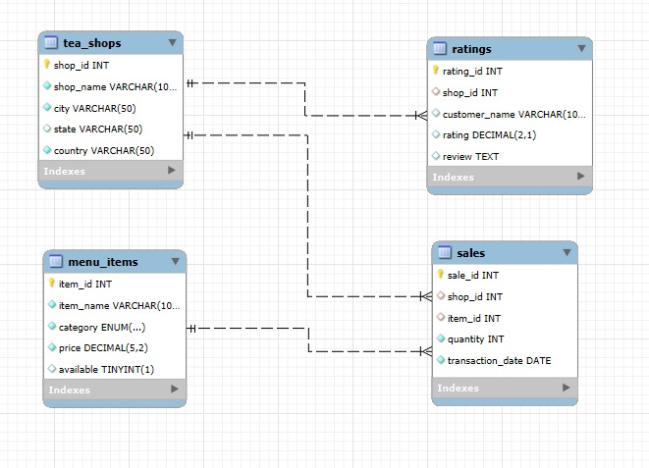
Entity Relationship Diagram (ERD)

Slide 5
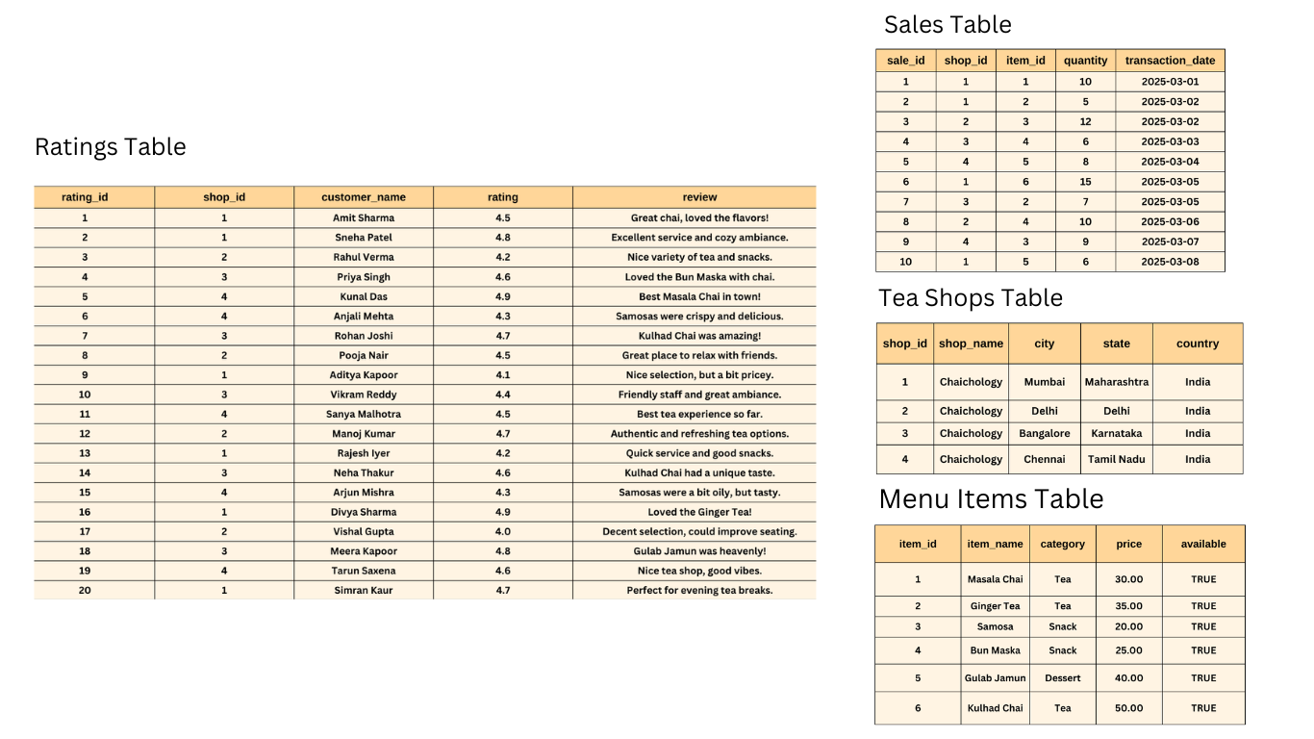
Tables

Slide 6

Creating DATAbase

Slide 7
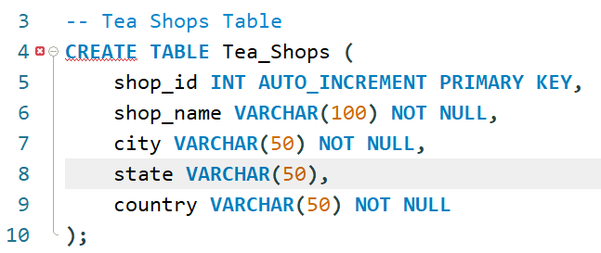
Creating TABLE Tea-SHOP

Slide 8
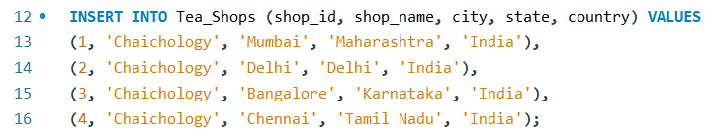
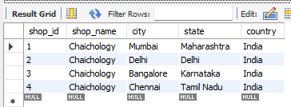
Insert values in the tea-shop table

Slide 9
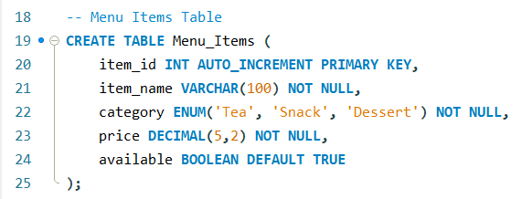
Creating TABLE Menu-Items

Slide 10
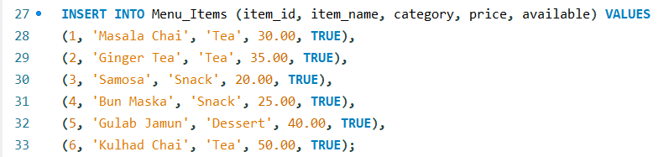
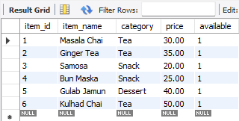
Insert values in the Menu-Item table

Slide 11
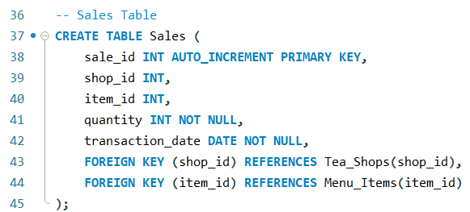
Creating TABLE Sales

Slide 12
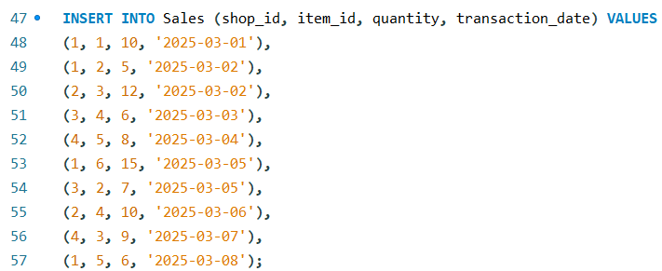
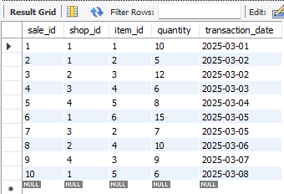
Insert values in the Sales table

Slide 13
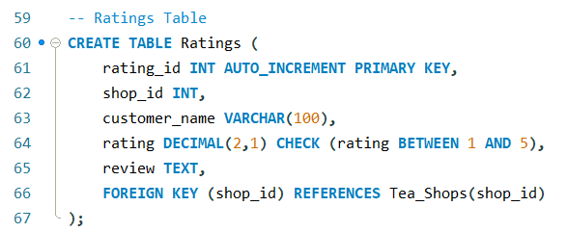
Creating TABLE Rating

Slide 14
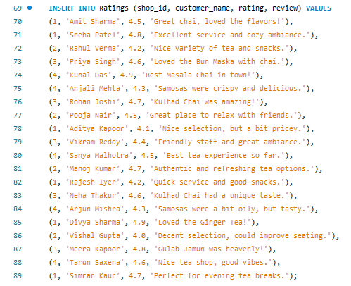
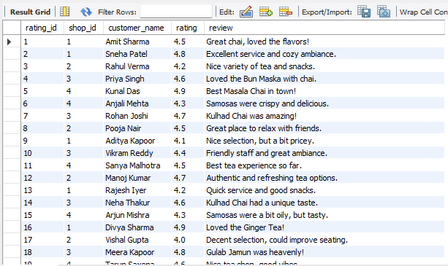
Insert values in the rating table

Slide 15
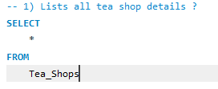
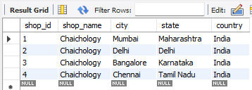
1. Lists all tea shop details

Slide 16
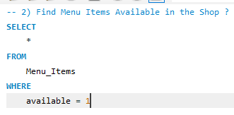
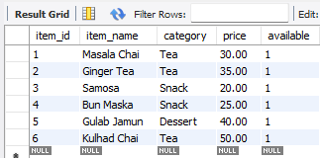
2. Find Menu Items Available in the Shop

Slide 17
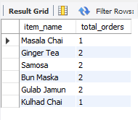
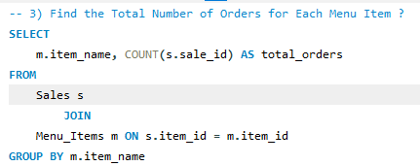
3. Find the Total Number of Orders for Each Menu Item

Slide 18
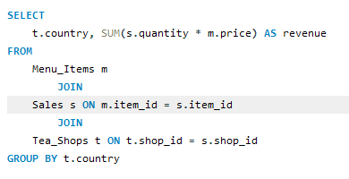

4. Find the Total Revenue Generated by Each Shop in different Locations

Slide 19
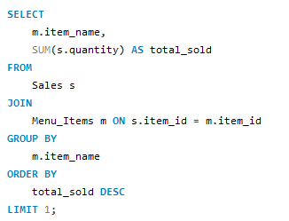

5. Find the Best-Selling Item

Slide 20
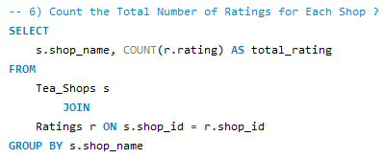

6. Count the Total Number of Ratings for Each Shop

Slide 21
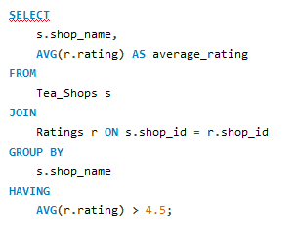

7. List All Shops with an Average Rating Above 4.5

Slide 22
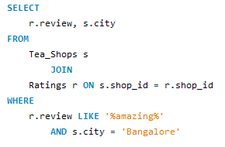

8. Find reviews where customers used the word "amazing" for a shop in Bangalore

Slide 23
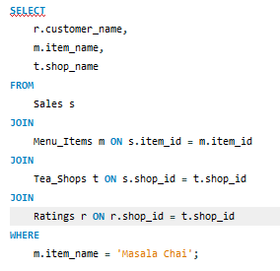
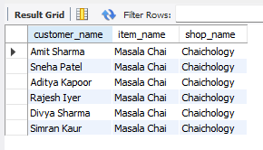
9. Find the names of customers who had Masala Chai and identify the tea shop where they consumed it

Slide 24
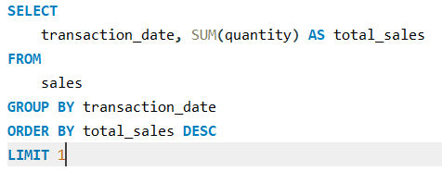

10. Find the day with the most sales

Slide 25
This case study strengthened my SQL skills through hands-on analysis of real-life business data. It highlighted the value of structured data and how powerful queries can drive business decisions.
Conclusion

Slide 26
This case study was a part of the Digits n Data SQL Challenge by @Digits n Data and @Nitish Kumar. It pushed me to apply SQL practically, solve real business problems, and boost my confidence in data analysis. I'm grateful for the opportunity and looking forward to more such learning experiences! Let’s Connect! Let me know your feedback or suggestions in the comments. Always happy to learn and grow together.
Final Thoughts

